Slide 1
JAVA CONCEPTS

Slide 2
Pantech?
Educational Equipment Manufacturer
IoT
Programmable Solution Provider – AI , ML & Java
AI/Robotics/Autonomous Robot, Microprocessor/Microcontroller
DSP,VLSI, Embedded System/
Power Electronics & Drives, Fuel Cell Trainer Kit
Renewable Energy Lab, Electric Vehicle Lab
Technical Training
DIY Project

Slide 3
Our Vision
Help 10 Million Students to Learn the Technology in Easy Way

Slide 4

What is Master Class ?
👍 This is the 30 Days Industrial Learning Activity.
👍 Its Online YouTube Live Class
👍 If you Invest 45 minutes daily, U will become Master in Java
👍 You will get E-Certificate
Webinar Participation Certificate
“Learning is the beginning of wealth.
Searching & Learning is where the miracle process all begins.” …………….Jim Rohn

Slide 5
How to mark your Attendance in YouTube Live Class?
Ans : During the Live Class, organizer will post Google Form link in Live Chat Only
Note : The Link will be available during the Live. From the LIVE Class date, the live video will get removed from the YouTube in 3 days.

Slide 6

Associate Partner

Slide 7
YOU HAVE THE OPTION TO CHOOSE WITH A WEBINAR CERTIFICATE OR GET ANY INTERNSHIP CERTIFICATE…

Slide 8
What U will Learn from 30 Days Java Master Class

Slide 9
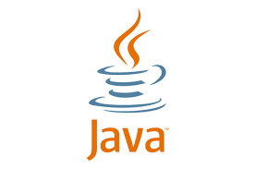
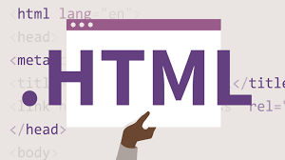
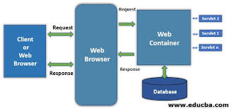
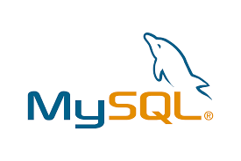

Java Full Stack Learning Plan
01
02
03
04
05
Java
HTML
Servlets
Mysql,JDBC
Java
Introduction To Java and OOPS Concepts
Basic elements,Paragraphs,Colors,Forms,Input Types
Project Building
Mysql Introduction,JDBC Components,Examples
Introduction,Exceptions,Database Access

Slide 10
Day wise Learning Plan
Day 1- Java Introduction | Installation
Day 2- Java Variables – Identifiers , Datatype, Classes and Objects
Day 3- Java Comments – Single line comments , multi-line comments
Day 4- Loops – Different types of loops , Decision Making Statements
Day 5- Ternary Operator , switch statement , Arrays and methods in Java
Day 6- Java Package , Access Modifiers , Java Strings, String Methods.
Day 7- Inheritance , Method Overloading , Method Overriding.
Day 8- Java – Type Casting , Abstract Class , Interface.
Day 9- Java Package , Access Modifiers, Encapsulation, Wrapper Class.
Day 10- Java Regular Expressions, Exception Handling .
Day 11- HTML Basic , Elements , Attributes , Headings
Day 12- HTML – Colors , CSS, links, images ,tables
Day 13- HTML – Forms, Form Attributes , Form Elements
Day 14- Servlet – Introduction, Life Cycle
Day 15- Servlets – Examples, Form Data, Client Request
Day 16- Servlets – Server Response , Http Codes , Writing Filters
Day 17- Servlets – Exceptions , Cookies Handling , Session Tracking
Day 18- Servlets – Database Access, File Uploading , Handling Date.
Day 19- MySQL – Introduction, Installation, Create Database, Drop database.
Day 20- MySQL – Data Types , Create Tables, Drop Tables, Insert Query
Day 21- MySQL – Select Query , Where Clause, Update Query , Delete Query, Like Clause , Sorting Results , Using Join.
Day 22- Introduction To JDBC, Jdbc Components , Driver Connections.
Day 23- JDBC Examples.
Day 24- JDBC Transactions.
Day 25- Erasure Coding
Day 26- Public Auditing
Day 27- Counselling Management System
Day 28 - Software Puzzle
Day 29 - Crime Management System.
Day 30 -Secure Multi-Owner Data Sharing.

Slide 11
List of Projects for Demo in YouTube Live
Erasure Coding(Day 25)
Public Auditing(Day 26)
Counselling Management System(Day 27)
Software Puzzle(Day 28)
Crime Management System(Day 29)
Secure Multi-Owner Data Sharing(Day 30)
All Projects in Netbeans

Slide 12
What you will get from this 30 Days Master Class?
You can attend YouTube Live Class
E-Certificate ( WEBINAR PARTICIPATION CERTIFICATE)

Slide 13
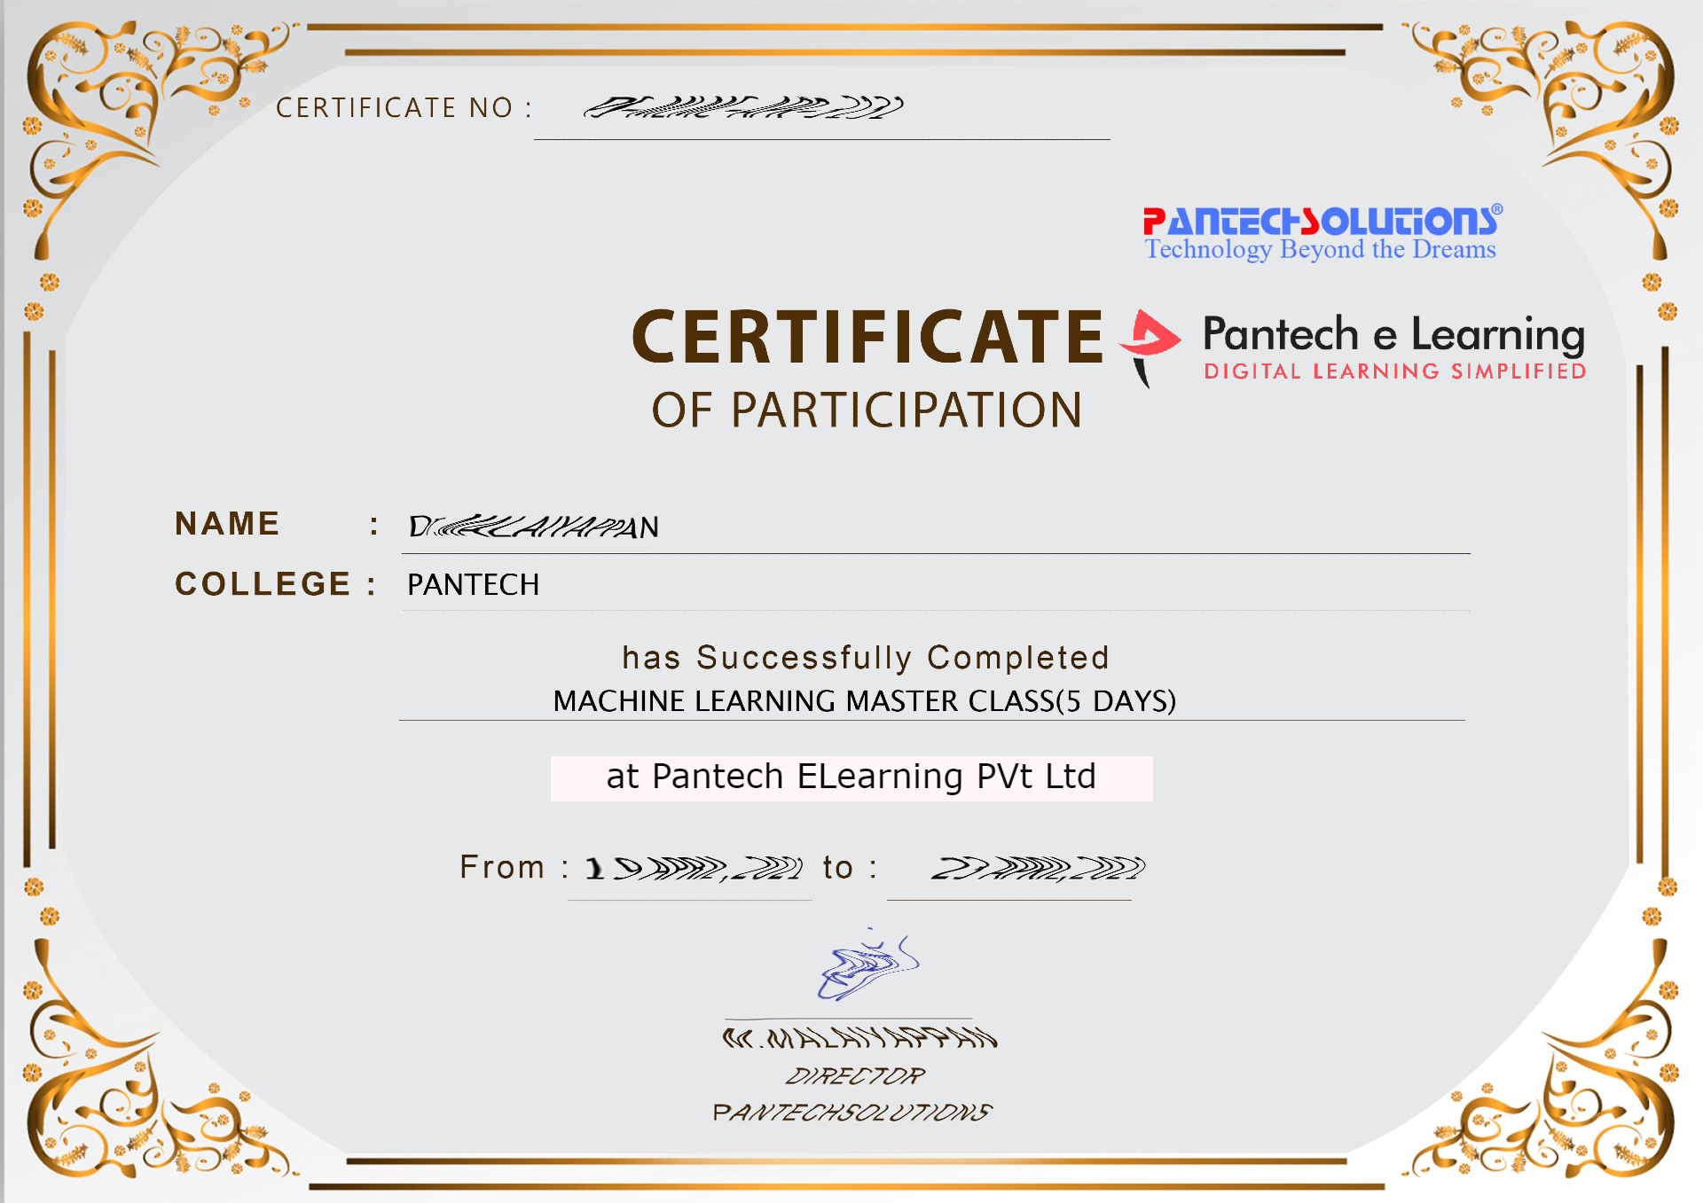

Sample Webinar Participation Certificate?

Slide 14
What is Internship????
Learn
Practice
Verify
Get Certified
Grow

Slide 15
Pantech will make you to create 6 Projects in Java in 30 Days
Objective of this 30 Days Master Class

Slide 16
1 Month Internship in Java Full Stack
INTERNSHIP E-Certificate (30Days Internship on Java Full Stack)
Highly organized Video content
Download Project Files
Download PPTs
Assignments
Weekly Hackathons
Flexible Time.
Access Period: 60Days from the date of payment
Community or Forum Support

Slide 17
What You Will Get???
Project Files of Java
30 Days Learning Practice
Servlet concepts
+ Projects
Erasure Coding(Day 25)
Public Auditing(Day 26)
Counselling Management System(Day 27)
Software Puzzle(Day 28)
Crime Management System(Day 29)
Secure Multi-Owner Data Sharing(Day 30)
Project PPT
Video Class Access for 2 Months
Get chance to Enroll 1-Month Internship on demand

Slide 18
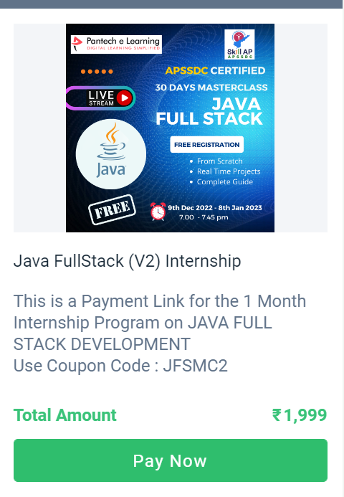
How to Enroll into 1 month Internship?
https://imjo.in/gHNkDr
REG FEE : Rs.1999 Rs.999
COUPON CODE : JFSMC2

Slide 19
What is Java?
It is an Object-Oriented Programming Language developed by Sun Microsystems and released in the year 1995.
Platform independent(i.e. , it can run on any platform).
Mainly based on the OOPS concept(Object Oriented Programming Systems).
It can be combined with other technologies like Spring , Hadoop and Android.

Slide 20
Why Java?
Easier to code and more secure than other programming languages.
Supports multithreading(i.e. , it can handle more than one request at a time).
Supports method reusability(i.e, a method can be written only once and used anywhere in the program which results in the reduction of code).
Other features of Java like Polymorphism , Abstraction, Encapsulation and Inheritance makes the programming language more robust and efficient.

Slide 21
Why Java?
Scalability:
We can achieve scalability by increasing the resources such as RAM and CPU in a single system.
Memory – Management:
Java provides its own mechanism for managing the memory is known as garbage collection.
It automatically deletes the objects when they no longer used by the application. It improves the speed of the application.

Slide 22
Reasons To Learn Java
It is one of the hottest programming languages in today’s world.
Millions of applications can be built with Java Programming Language.
Java is used in a variety of industries like tech , government , finance , healthcare , insurance , education and more.
The entry-level salary of a Java Developer is $59,053.With more experience , the salary can exceed $100,000.
So, Java developers make more money.

Slide 23
Different DOMAINS
J2SE(Java Platform, Standard Edition) – It is used to provide the core java functionality. It is mainly used to create Desktop Applications.
J2ME(Java Platform, Micro Edition) - It is used to create Applications on Mobile Devices.
J2EE(Java Platform, Enterprise Editions) – Enterprise version of Java is used for web-based Applications.

Slide 24
COMPONENTS OF JAVA
JVM: It provides an environment for executing Java Programs.
JDK: It is a software development environment and it contains the compiler , debugger and other classes to compile and debug a software program.
JRE: It provides a runtime environment to execute the Java programs and other applications.

Slide 25

APPLICATIONS OF JAVA:
Mobile App Development:
Most of the android applications build using Java.
The most popular android app development IDE Android Studio also uses Java for developing android applications.

Slide 26
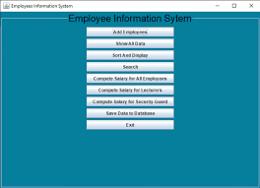
APPLICATIONS OF JAVA:

Slide 27
APPLICATIONS OF JAVA:
Desktop GUI Applications:
We can also develop a GUI application using Java.
Java provides AWT, JavaFX, and Swing for developing the GUI based desktop application.

Slide 28
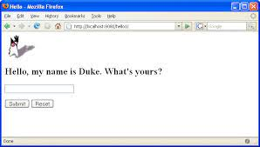
Web – based Applications:

Slide 29
Web – based Applications:
It is also used for developing the web-based application because it provides vast support for web development through Servlet, JSP, and Struts.
It is the reason that Java is also known as a server-side programming language. Using these technologies, we can develop a variety of applications.
The most popular frameworks Spring, Hibernate, Spring Boot, used for developing web-based applications.

Slide 30
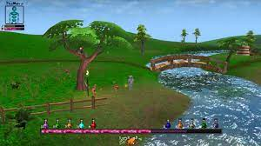
Game development:

Slide 31
Game development:
Java is widely used by game development companies because it has the support of the open-source most powerful 3D engine.
The engine provides unparalleled capacity when it comes to the context of the designing of 3D games.

Slide 32
BIG DATA TECHNOLOGY:
The tool Hadoop HDFS platform for processing and storing big data applications is written in Java.
In big data, Java is widely used in ETL applications such as Apache Camel and Apache Kafka.

Slide 33
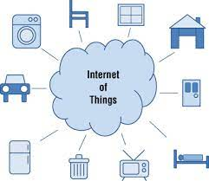
IOT APPLICATION:

Slide 34
IOT APPLICATION:
IoT is a technology that connects the devices in its network and communicates with them.
IoT has found almost in all the small devices such as health gears, smartphones, wearables, smart lighting, TVs, etc.
For developing the IoT application there is a lot of programming languages that can be used but Java offers an edge to developers that is unparalleled.

